Slide 1
Software Design
Cloud Provisioning System
Group #:1
Group Leader : Edwin Malek
Group Member : Dionny Stantiago, Xiaoyu Dong

Slide 2
Purpose of Project
The purpose of the cloud provisioning system (CPS) consists of two majors Objectives.
The first is to provide the user with a modeling environment where one can easily construct a diagram of cloud instances and their relationships.
The second is take the user create model and realize it in the cloud, providing the user with the infrastructure that he/she envisioned in the diagram.

Slide 3
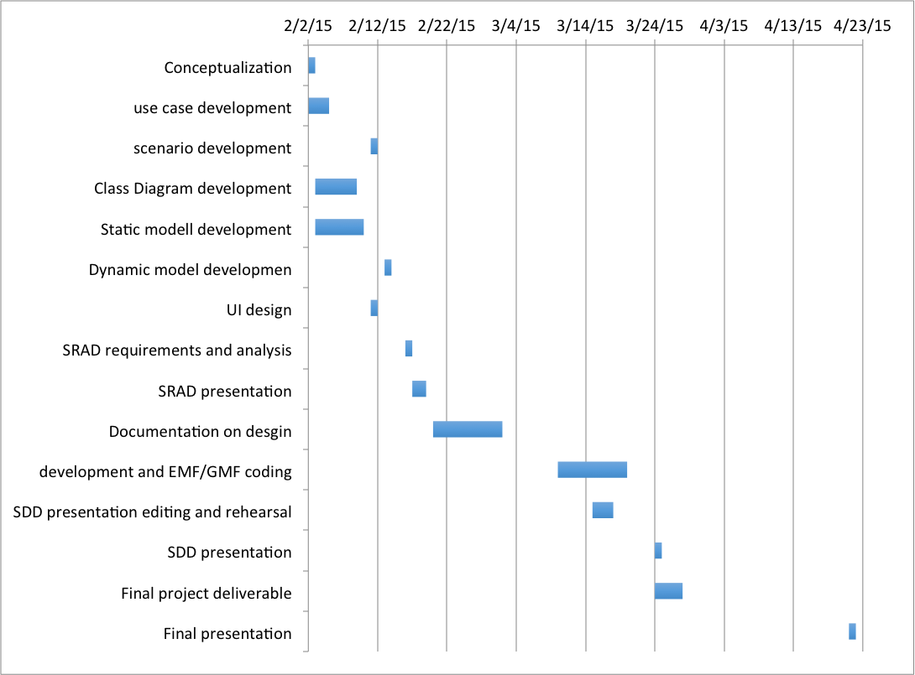
Project Schedule
Notes:
Edwin

Slide 4
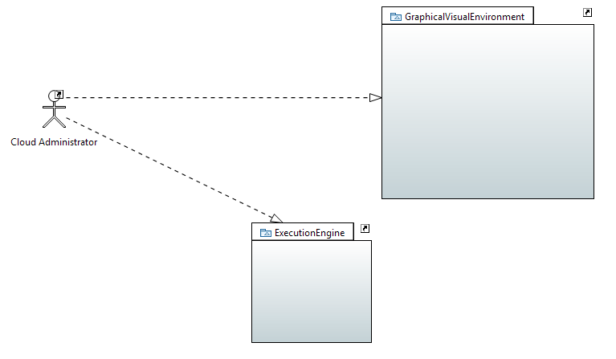
Use Case Diagram
Notes:
mathew

Slide 5
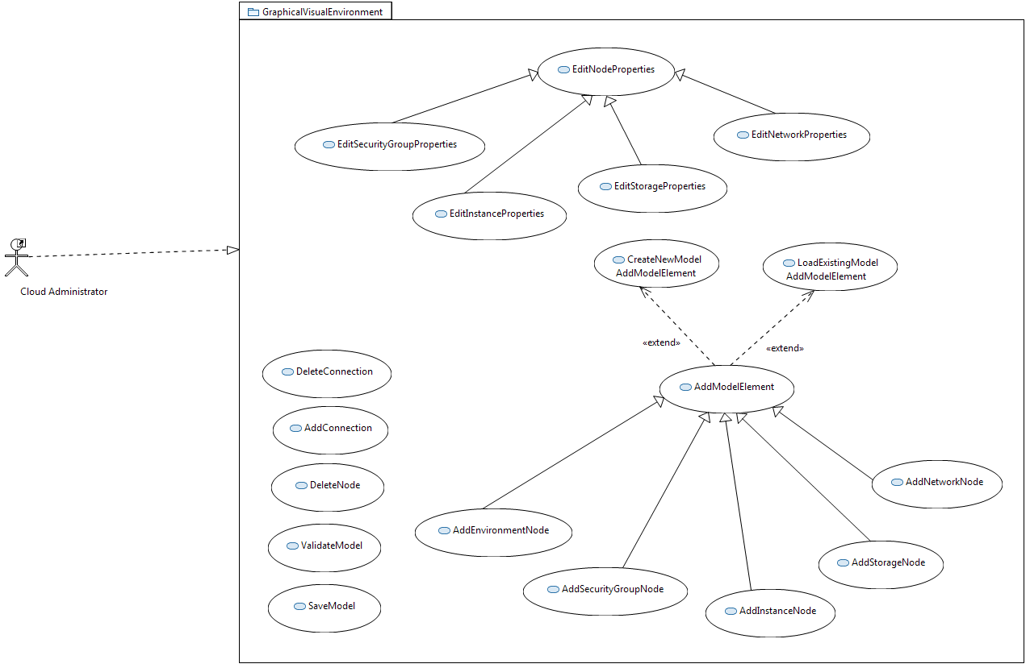
Use Case Diagram
Notes:
mathew

Slide 6
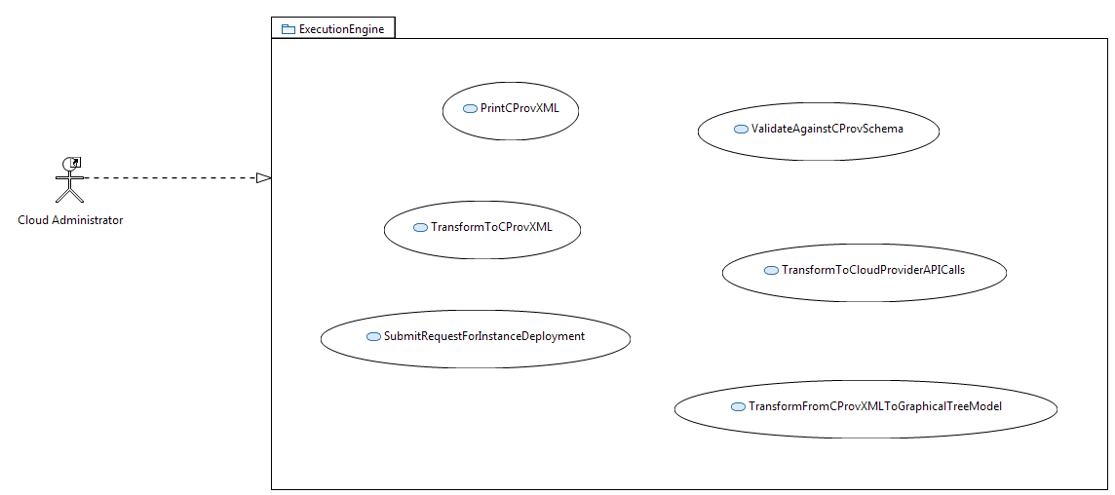
Use Case Diagram
Notes:
mathew

Slide 7
System Requirements
Use case 1
CPROV-EE Actors
Cloud Administrator - A cloud provisioning administrator who is interested in modeling a particular deployment.
CPROV-EE Use Cases
Use Case ID: CPROVME001 Create New Model
Details:
Actor: Cloud Administrator (Main user)
Pre-conditions:
1. The graphical visualization environment must be running on the system.
Description:
1. Trigger: the use case begins when the user clicks on a File button located on the top left hand side of the workspace.
2. The user selects the “New CPROV Model” button.
3. The system opens a new diagram in the currently select Project folder.
4. The system displays a window for the user to enter a Name for the Model.
5. The user enters a name for the model.
6. The user clicks the “OK” button to confirm.
7. The system switches focus to the newly created model workspace.
Post-conditions:
1. The system creates a new Model along with its tree representation located on the left hand side of the workspace.
Notes:
Edwin

Slide 8
Create Model Con’t
Alternative Courses of Action:
In step D.2 (step 2 of Descriptions section) the user can choose to save a Model by selecting the model and pressing “CTRL-N”.
---------------------------------------------------------------------------------------------------------------------
Decision Support
Frequency:
Each and every time the main user would like to save a model.
Criticality:
High, It allows the user to create a new model.
Risk:
High to Low risk, the system EMF/GMF framework handles Model file creation.
Notes:
Edwin

Slide 9
System Requirements
Use case 2
CPROV-EE Actors
Cloud Administrator - A cloud provisioning administrator who is interested in modeling a particular deployment.
CPROV-EE Use Cases
Use Case ID: CPROVEE003 Validation against Cloud provisioning Schema
Details:
Actor: Cloud Administrator (Main user)
Pre-conditions:
The graphical visualization environment must be running on the system.
A model must be active and must contain at least an instance of a server.
Description:
Trigger: the use case begins when the user clicks right clicks on the workspace.
In the right click drop down menu, the user clicks on the “Validate”
The system start to validation process with a progress bar starting at 0 % and ends at 100% showing that the validation has been done.
The system responds by...
•Relevant requirements: java virtual machine, Windows 7 & 8/Mac OS 10.2 and up/Linux debian/Ubuntu, CPU of 2 GHZ and up, RAM 2 GB.
Post-conditions:
A message appears stating that the validation process reported errors or no errors.
The system returns focus to the graphical elements present on the workspace.
Notes:
Edwin

Slide 10
System Requirements
Use case 2 con’t
Alternative Courses of Action:
In step D.2 (step 2 of Descriptions section), the user has the option select validate from the menu bar under “Validation”.
*Exceptions:
if One or more element of the diagram does not respect UML protocol. In this case the error(s) are highlighted in the validation submenu located in the lower part of the screen.
*Related Use Cases:
-CPROVME005 Add Instance Node.
---------------------------------------------------------------------------------------------------------------------
Decision Support
Frequency: Each time the main user would like to validate the diagram.
On average once per changes applied to the model.
Criticality: High, It allows the user to verify is the diagram represents a sound model before the translation and deployment phases.
Risk:
Risk: low risk, the system uses the EMF/GMF API to implement the validation.
Notes:
Edwin

Slide 11
Scenarios (ME, EE)
Use Case ID: SCE1-CPROVEE003 Validation against Cloud provisioning Schema
Details:
Actor: Jose Gonzalez (Cloud Administrator)
Pre-conditions:
The graphical visualization environment must be running on the system.
A model is active and contains an Environment connected to an Instance, and a Storage node connected to the same Instance.
Description:
Use case begins when Jose Gonzalez clicks right clicks on the workspace.
In the right click drop down menu, Jose Gonzalez clicks on the “Validate”
The system starts to validation process with a progress bar starting at 0 % and ends at 100% showing that the validation has been done.
The system responds by...
•Relevant requirements: java virtual machine, Windows 7 & 8/Mac OS 10.2 and up/Linux debian/Ubuntu, CPU of 2 GHZ and up, RAM 2 GB.
Post-conditions:
A message appears stating that the validation process reported errors or no errors.
The system returns focus to the graphical elements present on the workspace.
Alternative Courses of Action:
In step D.2 (step 2 of Descriptions section), Jose Gonzalez has the option select validate from the menu bar under “Validation”.
Notes:
Edwin

Slide 12
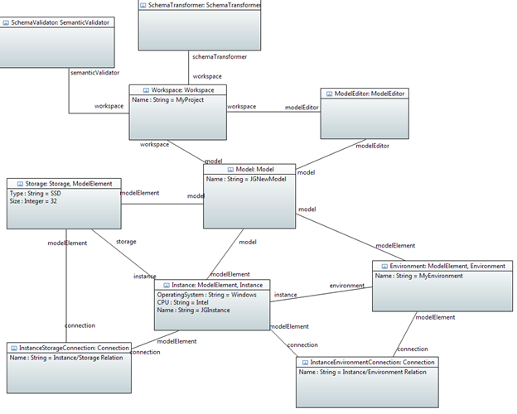
Scenarios (Object Diagrams)

Slide 13
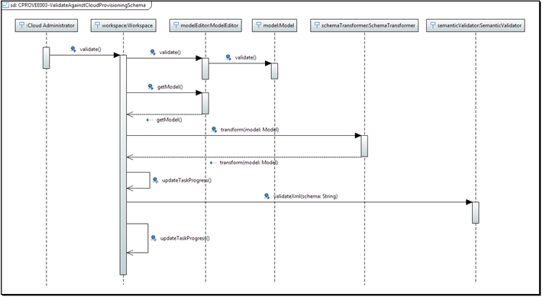
Sequence Diagram

Slide 14
Scenarios (ME, EE)
Use Case ID: SCE1-CPROVME001 Create New Model
Details:
Actor: Henry Smith (Cloud Administrator)
Pre-conditions:
The graphical visualization environment must be running on the system.
Description:
Trigger: the use case begins when Henry Smith clicks on a File button located on the top left hand side of the workspace.
Henry Smith selects the “New CPROV Model” button.
The system opens a new diagram in the currently select Project folder.
The system displays a window for Henry Smith to enter a Name for the Model.
Henry Smith enters “MyNewModel” for the name.
Henry Smith clicks the “OK” button to confirm.
The system switches focus to the newly created model workspace.
The system responds by...
•Relevant requirements: java virtual machine, Windows 7 & 8/Mac OS 10.2 and up/Linux debian/Ubuntu, CPU of 2 GHZ and up, RAM 2 GB.
Post-conditions:
The system creates a new Model along with its tree representation located on the left hand side of the workspace.
Alternative Courses of Action:
In step D.2 (step 2 of Descriptions section) Henry Smith can choose to save a Model by selecting the model and pressing “CTRL-N”.
Notes:
Edwin

Slide 15
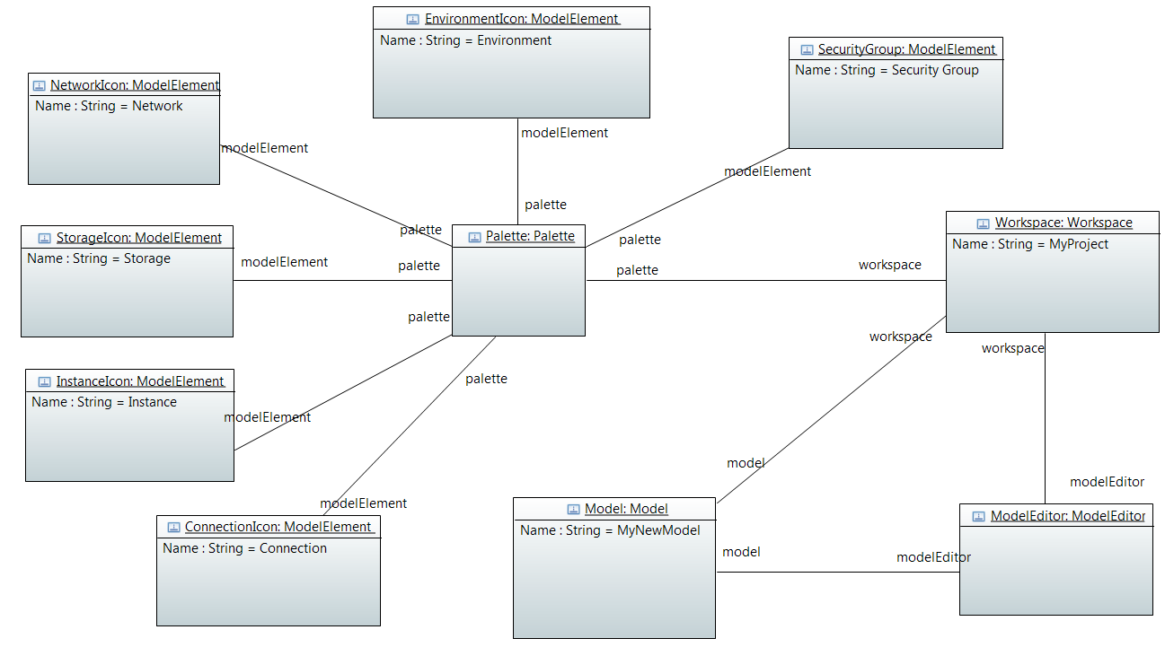
Scenarios (Object Diagrams)

Slide 16
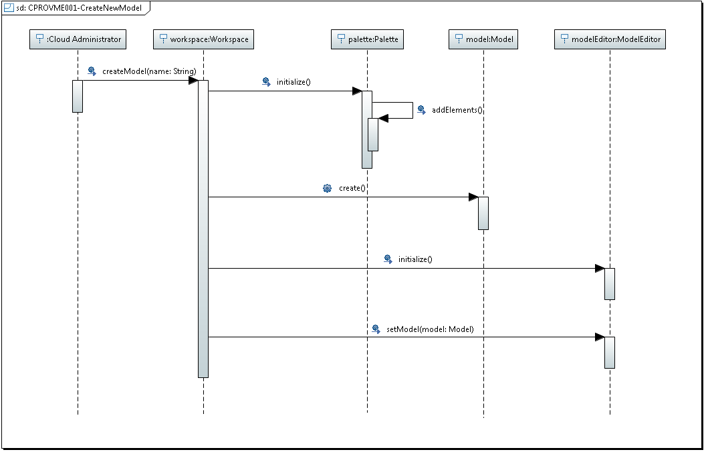
Sequence Diagrams

Slide 17
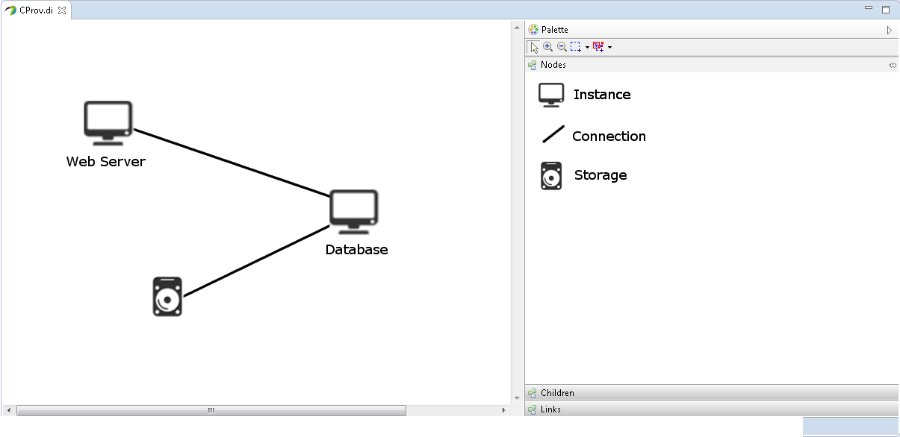
User Interface

Slide 18
User Interface

Slide 19
Question ?

